Slide 1
Data Warehousing Basics
Basics Of Data Warehouse
Level - Learner

Slide 2







Overview
This session provides knowledge and understanding of concepts related to Data Warehouse like DW Definition, Features, Data, Business Benefits, Application Areas, Architecture, Implementation and Differences from Operational Systems.
Data Warehouse definition
Features & data of Data Warehouse
Diff from Operational Systems
Data Warehouse Fundamentals
Business Benefits
Application Areas
Architecture and Implementation
Notes:
Now you know what is operational data and the need of Operational data.
But when the business needs to make decisions or strategies it needs informational system which is nothing but our Data Warehouse. Here you learn what is a data warehouse and how we design it.
Welcome to Data Warehousing Fundamentals!!!!

Slide 3
Objectives
After completing this session, associate will be able to :​
Define Data Warehouse?
Explain the need for a Data Warehouse?
Describe the structure of a Data Warehouse?
List the differences between a Warehouse and an Operational system?

Slide 4
Need for Data Warehouse
Operational data helps the organization to meet the operational and tactical requirements for data.
The Data Warehouse data helps the organization to meet strategic requirements for information.
The strategic data helps the business with the following needs:
• Understand Business Issues
• Analyze Trends and Relationships
• Analyze Problems
• Discover Business Opportunities
• Plan for the Future

Slide 5
Data Warehouse Fundamentals
The Data Warehouse is a collection of data in support of management decision processes, which is:
Subject oriented
Integrated
Time variant
Non-volatile
A Data Warehouse is a relational database that is designed for query and analysis.
It usually contains historical data derived from transaction data and other sources.

Slide 6
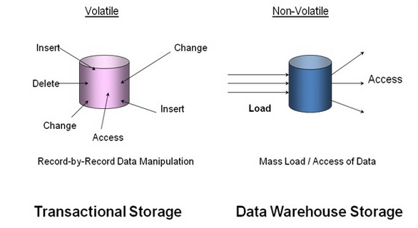
Transactional vs Data Warehouse Storage
The way of storage of data in operational and Data Warehouse Systems

Slide 7
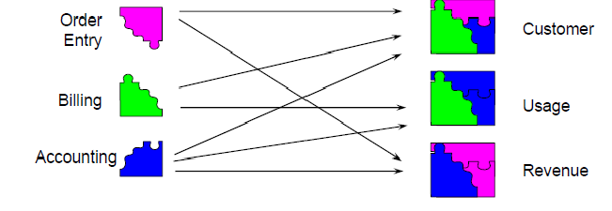
Differences from Operational Systems
Operational Systems Data Warehouse
Operational data is organized by specific processes or tasks and is maintained by separate systems.
Warehoused data is organized by subject area and is populated from many operational systems.

Slide 8
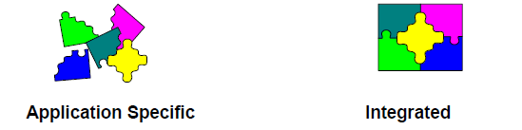
Differences from Operational Systems (Contd.)
Operational Systems Data Warehouse
Applications and their databases were designed and built separately.
Evolved over long periods of time.
Integrated from the start.
Designed (or “Architected”) at one time, implemented iteratively over short periods of time.

Slide 9
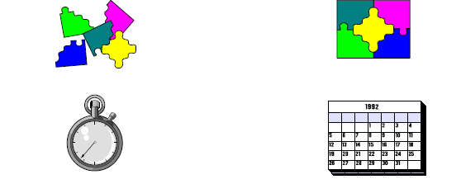
Differences from Operational Systems (Contd.)
Operational Systems Data Warehouse
Primarily concerned with current data. Generally concerned with historical data.

Slide 10
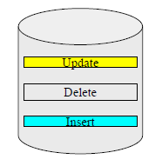
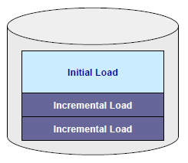
Differences from Operational Systems (Contd.)
Operational Systems
Data Warehouse
Load/
Update
Constant Change
Consistent Points in Time
Updated constantly.
Data changes according to need, not as a fixed schedule.
Added regularly, but loaded data are rarely changed directly.
Does not mean the data warehouse is never updated or never changes.

Slide 11
Data in Data Warehouse
Characteristics of the data in a Data Warehouse:
Separate DSS data base
Storage of data only, no data is created
Integrated and scrubbed data
Historical data
Read-only (no recasting of history)
Various levels of summarization
Meta data
Subject oriented
Easily accessible

Slide 12
Features of Data Warehouse
Strategic enterprise level decision support
Multi-dimensional view on the enterprise data
Caters to the entire spectrum of management
Descriptive, standard business terms
High degree of scalability
High analytical capability
Historical data only

Slide 13
Data Warehouse: Benefits to Business
Understand business trends.
Better forecasting decisions.
Better products to market in timely manner.
Analyze daily sales information and make quick decisions.
Solution for maintaining your company's competitive edge.

Slide 14
Data Warehouse: Application Areas
Risk management
Financial analysis
Marketing programs
Profit trends
Procurement analysis
Inventory analysis
Statistical analysis
Claims analysis
Manufacturing optimization
Customer relationship management

Slide 15
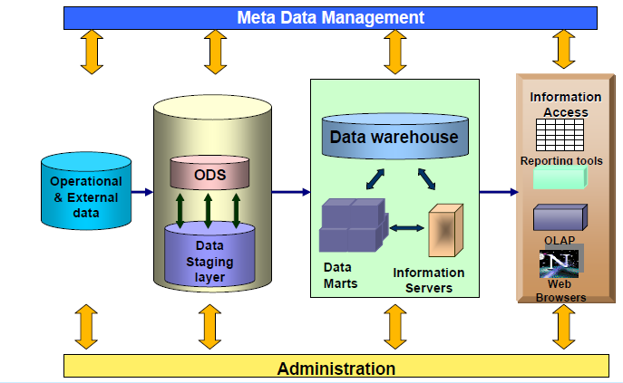
Data Warehouse Architecture

Slide 16
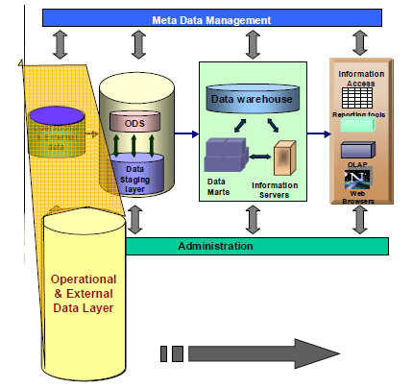
Operational and External Data Layer
The Database-of-record
Consists of system specific reference data and event data
Source of data for the data warehouse
Contains detailed data
Continually changes due to updates
Stores data up to the last transaction

Slide 17
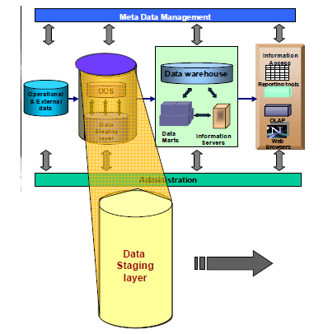
Data Staging Layer
Extracts data from operational and external databases.
Transforms the data and loads into the Data Warehouse.
This includes decoding production data and merging of records from multiple DBMS formats.

Slide 18
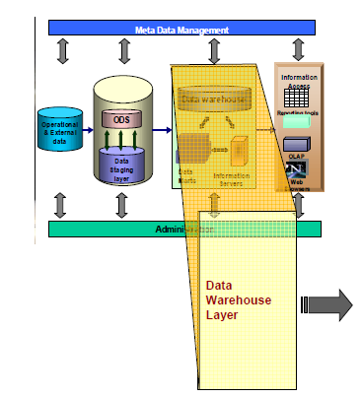
Data Warehouse Layer
Stores data used for informational analysis.
Present summarized data to the end-user for analysis.
The nature of the operational data, the end-user requirements and the business objectives of the enterprise determine the structure.

Slide 19
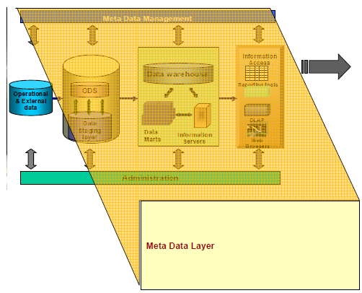
Meta Data Layer
Metadata is data about data.
Stored in a repository.
Contains all corporate metadata resources: database catalogs and data dictionaries.

Slide 20
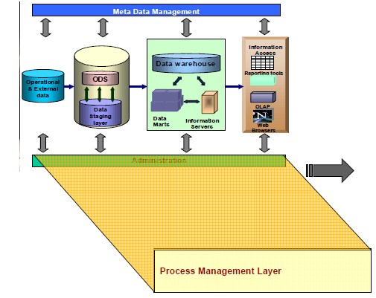
Process Management Layer
Scheduler or the high-level job control.
To build and maintain Data Warehouse and the data directory information.
To keep the Data Warehouse up to date.

Slide 21
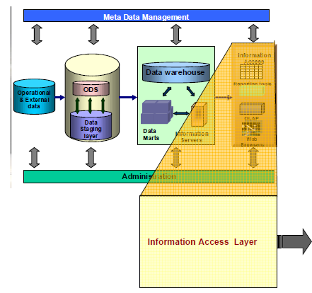
Information Access Layer
Interfaced with the Data Warehouse through an OLAP server.
Performs analytical operations and presents data for analysis.
End-users generate ad-hoc reports and perform multi dimensional analysis using OLAP tools.

Slide 22
Data Warehouse Architecture: Implementation
The following should be considered for a successful implementation of a Data Warehousing solution:
Architecture:
Open Data Warehousing architecture with common interfaces for product integration.
Data Warehouse database server.
Tools:
Data Modeling tools
Extraction and Transformation/propagation tools
Analysis/end-user tools: OLAP and Reporting
Metadata Management tools

Slide 23
Questions

Slide 24
Test Your Understanding
What type of data is stored in a data warehouse?
How is an operational system different from a Data Warehouse?
What are the layers involved in the Data Warehouse architecture?
What are the requirements to implement an EDW architecture?

Slide 25
Recap
After completing this session, associate should be able to :​
Define Data Warehouse?
Explain the need for a Data Warehouse?
Describe the structure of a Data Warehouse?
List the differences between a Warehouse and an Operational system?

Slide 26
Thank You
You have successfully completed the session on Basics of Data warehouse.

